Slide 1
Great Lakes District SSAR Strategic Plan 2023-2028
VPG David W. Van Hoof
August 4, 2023

Slide 2
2023-2024 Strategic Planning & Advisory Committees (Proposed)
Strategic Planning Committee *
David W. Van Hoof (Vice President General; Chairman)
Robert Hugland (WISSAR President; Vice-Chairman)
Donald Skarda (WISSAR 1st VP)
Mickey McGuire (MISSAR President)
Joe Williams (MISSAR State 1st VP)
Richard Ruedin (ILSSAR President)
Bill Wheeler (ILSSAR 1st VP)
* For voting purposes, each member state will have only one vote.
Strategic Planning Advisory Committee *
Tobi Chamberlain (Past VPG GLD 2022-2023)
Bill Austin (Past VPG GLD 2021-2022)
Jim Petres (Past VPG GLD 2019-2021)
Bill Sharp (Past VPG Central District)
Paul Callanan (Past VPG, Minuteman, etc)
Ken Goodson (Past VPG, Minuteman, etc)
Elijah Shalis (GLD Secretary)
Dennis VanWormer (StratPlan Advisor)
* Non-voting members.

Slide 3
GLD Purpose, Vision, & Mission
PURPOSE: To facilitate State Societies and Chapters in keeping alive the history of the American Revolution by honoring our patriot ancestors and conveying their stories to the world.
VISION: To be the foremost district in the NSSAR engaged in promoting the development of our nation from its founding principles.
MISSION: To conduct patriotic, historical and educational activities and programs which perpetuate the memory of the men and women, who by their services and/or sacrifices during the war of the American Revolution, achieved the independence of the American people.
(Vision and mission statements from NSSAR Strategic Plan 2025. Purpose statement added by MISSAR Committee.)

Slide 4
Core Values
Our values serve as a compass for our actions and describe how we behave in the world.
VALUE ACTION STATEMENT
Integrity Be real. Be honest. Be upright in our actions.
Patriotism Devoted love, support, and defense of one’s country.
Leadership The courage to shape a better future.
Education Informing the public about our country’s founding.
(From NSSAR Strategic Plan 2025)

Slide 5
S.M.A.R.T. Objectives
Specific
Is the objective clear? Who will be involved? What will be accomplished? Where will the work happen? When will the work happen? Will the objective lead to the desired results?
Measurable
What will be measured to show progress and completion of the objective? When will interim measurements take place and what will be measured then?
Achievable
Is the objective realistic? Are the limitations and constraints known and understood? Can it be done within the proposed timeframe?
Relevant
Why does this objective matter? Will it make a measurable improvement to the issue? Is this the proper time for this objective?
Time-bound
When will this objective be accomplished? What is the stated deadline? Are there interim deadlines?

Slide 6
2023-1 – Encourage & Assist State Societies in developing and executing Strategic Plans that support the NSSAR 250th efforts. VPG – FACILITATE; State Presidents EXECUTE
Strategic Objective: All Member State Societies have a draft strategic plan that supports NSSAR’s 250th plan developed and ready for submission to their membership at their 2024 Annual Meetings.
Major Tasks & Timing:
Assess the status of State Societies in accomplishing and executing a strategic plan.
Using MISSAR SMEs – provide a Zoom meeting to review format, timeline, execution, pitfalls, hurdles, successes and best practices; provide templates.
Conduct periodic zoom meetings with designated State Strategic Planning Representatives to discuss issues.
Facilitate State Presidents in accomplishing a final product for their society to vote upon at their annual meetings (Spring 2024).

Slide 7
2023-2 – District serves as a conduit between Chapter and State societies with NSSAR in conducting 250th Anniversary projects, events and efforts. VPG – LEAD; State Presidents FACILITATE
Strategic Objective: To serve as a conduit between chapter and state societies with NSSAR SMEs in conducting 250th Anniversary projects, events and efforts.
Major Tasks & Timing:
Prove a NSSAR SME POC to facilitate communications between NSSAR subject matter experts (SMEs) and NSSAR committee members with state society counterparts within the district (i.e. 250th Committee, Youth Awards Committee, Color Guard Committee, Grave Marking / Cemetery Plaque Committees, Flag Committee.
Encourage member states’ Presidents, 1st VPs, Immediate State Past Presidents be involved in the NSSAR Council of State Presidents.
Encourage State Presidents to ensure that SME information is getting down to the Chapters.

Slide 8
2022-3 – Recruit Non-traditional Members from “Untapped” Urban Areas; VPG & State Presidents DEVELOP and EXECUTE
Strategic Objective: To stimulate membership growth in member states, in particular non-traditional members; and more specifically, those “untapped” urban areas which have the greatest potential for minority membership (i.e. Michigan- metro Detroit; Illinois – metro Chicago; Wisconsin – metro Milwaukee).
Major Tasks & Timing:
Contact NSSAR SME experts and develop a forum (Zoom meetings) in which best practices in reaching out to the minority groups can be discussed and developed.
Partner with Daughters of the American Revolution, Children of the American Revolution and Sons of the Revolution in minority specific membership drives.
To capitalize on Wisconsin State Society’s rapport with the Oneida and Mohican Tribes of Wisconsin, and ally with them in respectively developing their own SAR chapters.

Slide 9
2022-4 – Review With State Presidents the possibility of Hosting a NSSAR Congress; VPG, Future VPGs & State Presidents DEVELOP and FORMULATE a Plan
Proposed Strategic Objective: Review the possibility of Great Lakes District hosting a Congress during the 250th Celebration period; most likely Chicago, during a timeframe in which Illinois holds the VPG GLD position; the ideal year being 2031.
Major Tasks & Timing:
VPG GLD and member State Presidents conduct feasibility of hosting a NSSAR Congress and most likely location.
If presidents vote favorably, VPG GLD discusses location with NSSAR SME (currently VPG Paul Callanan).
VPG GLD, NSSAR SME conducts Zoom Meeting with State Presidents and discusses feasibility, pros/cons, responsibilities, costs, required coordination w/ NSSAR.
Follow-on actions TBD pending Zoom Meeting w/ NSSAR SME.

Slide 10
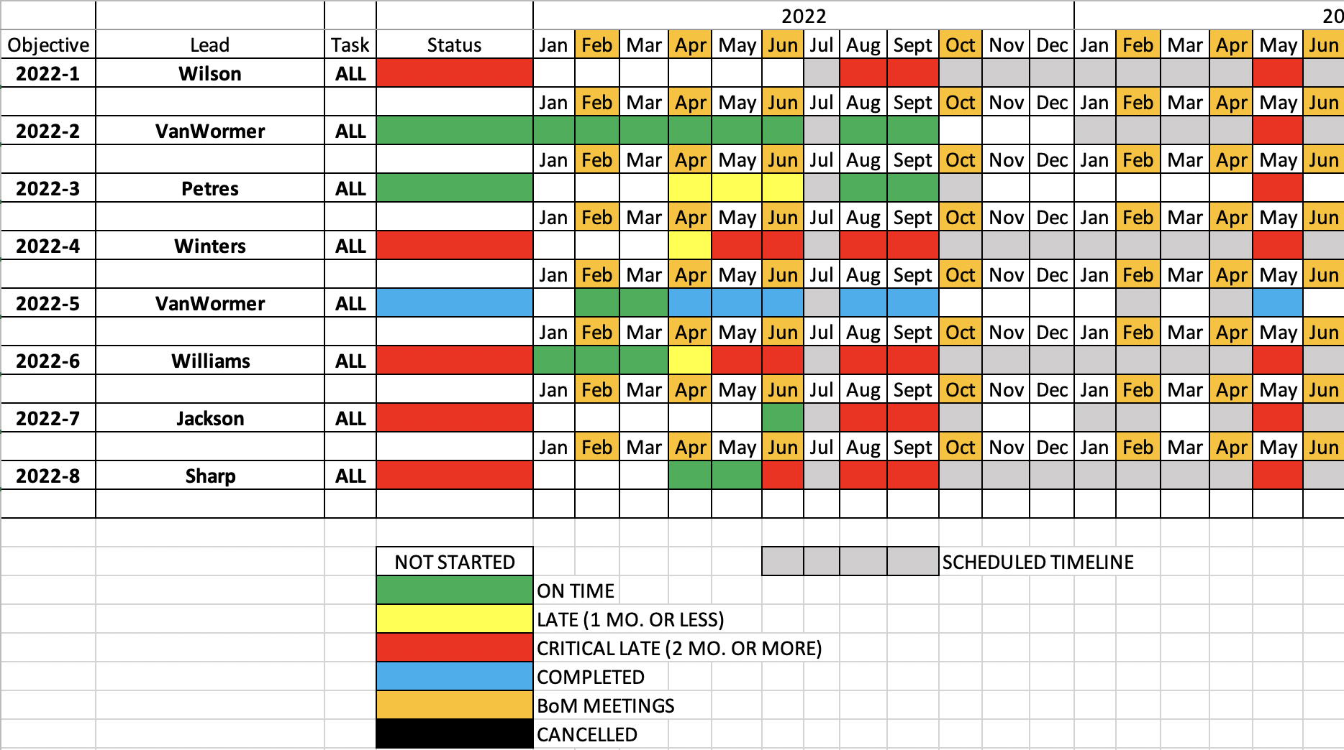
Status of Strategic Objectives (SAMPLE)

Slide 11
Questions?

Slide 12
GLD SWOT List (Strengths, Weaknesses, Opportunities, Threats)
The organization that we are concerned about is the Great Lakes District. Given that State Societies (MISSAR, ILSSAR, WISSAR) are the strongest organizations within the District, their adoption of the District Strat Plan is key. As the role of VPG rotates among the states, it will be the successor VPGs who will ensure the goals of the StratPlan are carried out. Strengths and Weaknesses are our internal positive and negative traits – things that are inside our sphere of control. Opportunities and Threats are external positive and negative traits – things that are outside our sphere of control but inside our sphere of concern. We may or may not be able to have some influence on these external areas, but we cannot control them. We can only control (at best!) what goes on inside the district & state organization.

Slide 13
Strengths (internal positive traits – what we are good at that gives us an advantage)
Level of patriotism of our compatriots
Resilient membership
Generosity of our compatriots (Donations, & contributions)
Excellent leaders and subject matter experts
Active Color Guard participation at chapter, state, district & national events
Marking Graves of Revolutionary War Patriots
Using National SAR Members Website and Application System
Recognition of Local Communities
Strong partnership with DAR, C.A.R., SR and First Nations Allies

Slide 14
Weaknesses (internal negative traits – what prevents us from doing better)
Geography
Small membership as compared to other Districts/State Societies
Leadership and workload accomplished by a small minority
Limited communications between member states
Limited District budget; limited District staff
Inability to attract and retain officers, especially those younger than 50
Need to be more proactive in developing our state leadership
Lack of school visits / education presentations

Slide 15
OPPORTUNITIES (external positive factors that can give us even more advantage)
1. NSSAR 250th Anniversary program
2. NSSAR educational, historical, and genealogical resources
3. Universities (i.e. Big 12; Univ of Chicago; Clements Library – resources and curricula)
4. Grave marking and cemetery marker programs
5. DAR & C.A.R.
6. Remote meeting technology to accomplish coordination, training and committee work.
NOTE: Numerous items mentioned as opportunities that do not meet the definition; they tended to be possible solutions to existing weaknesses or threats (i.e., more local chapters, new member mentoring program)

Slide 16
THREATS (external negative factors that can harm our advantages)
1. Apathy of compatriots
Demographics of membership conveys the image of elitism, elderly, out of touch.
Zoom fatigue
Political divisiveness
Re-evaluated American History v. Revisionist History
6. Confusion with right wing extremist organizations because of our name and color guard uniforms.

